Slide 1
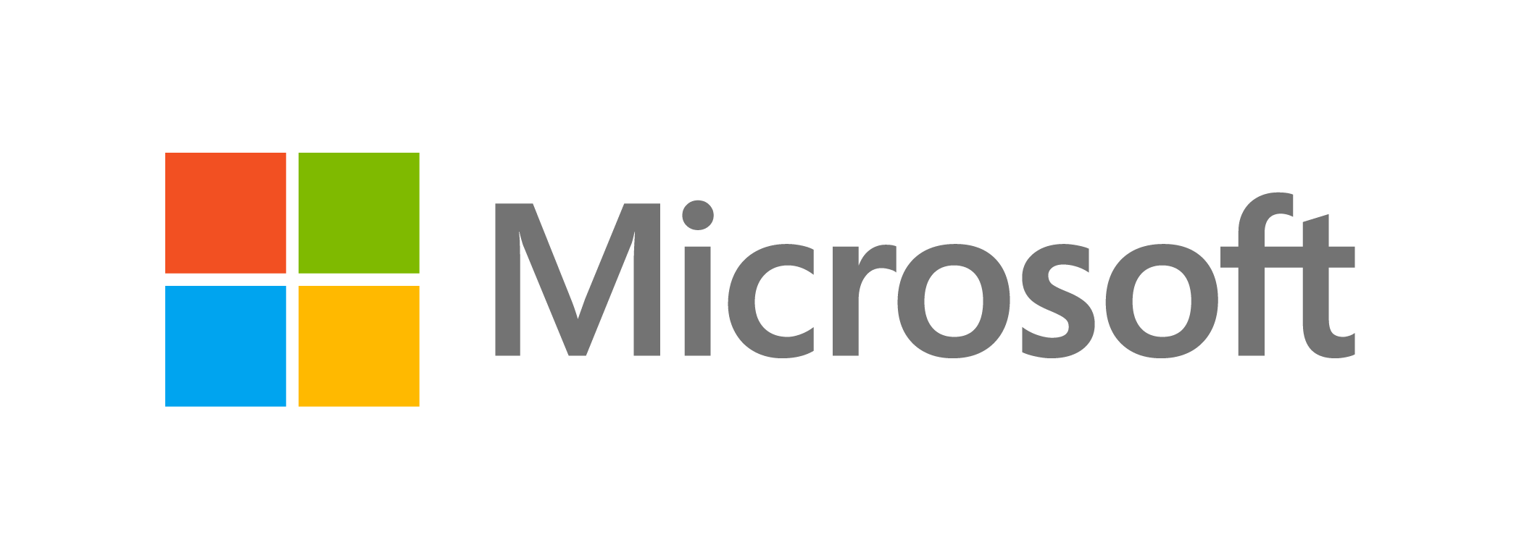






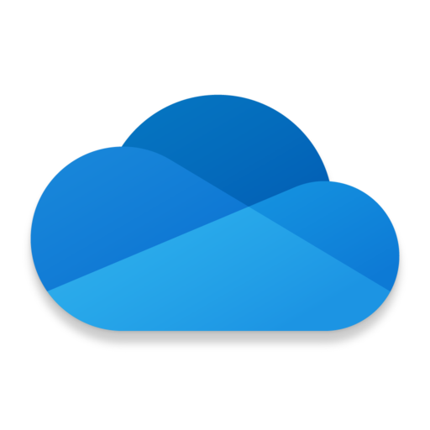
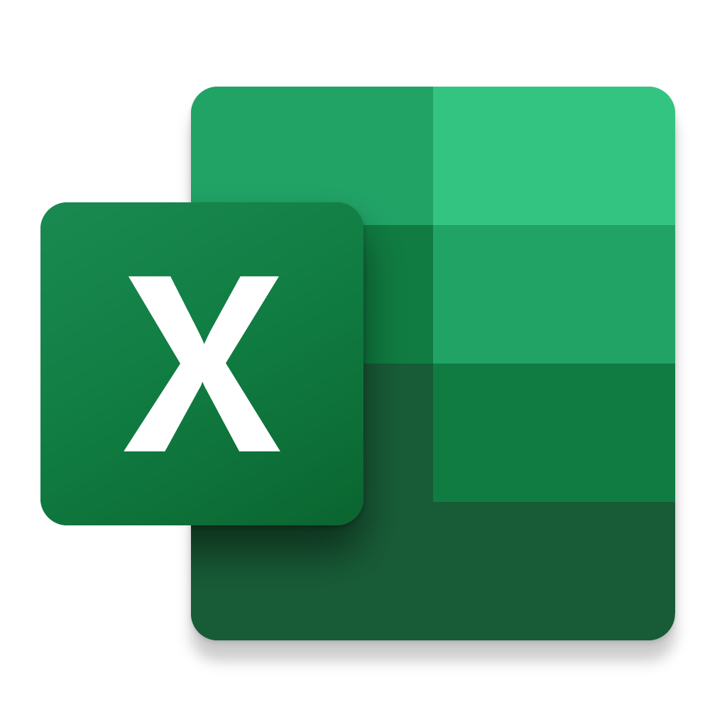
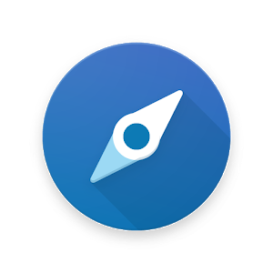
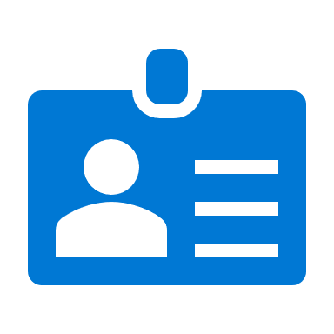
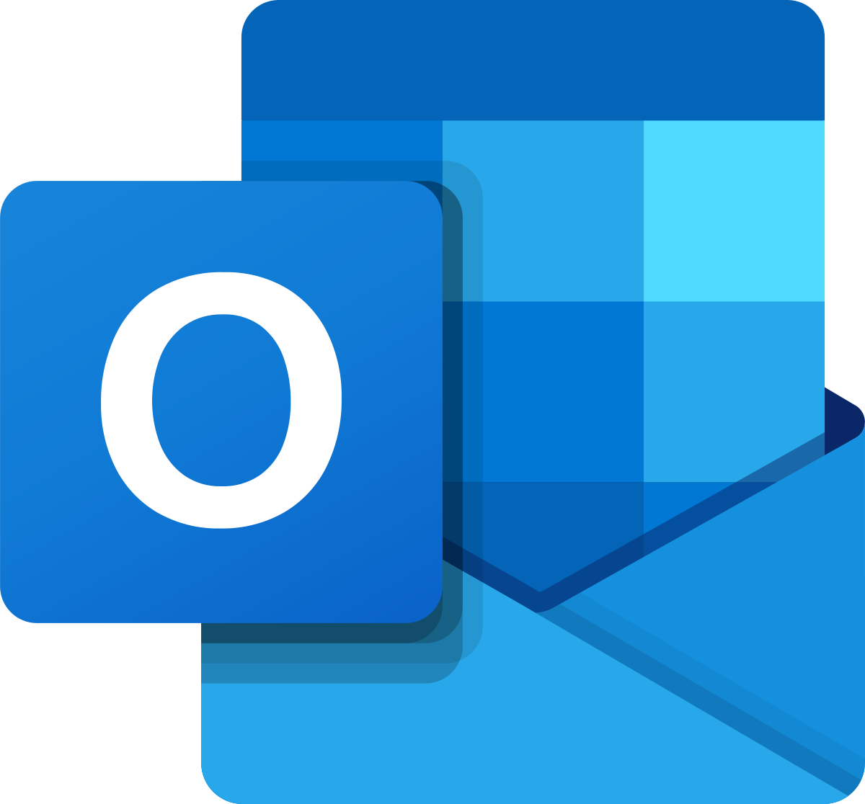
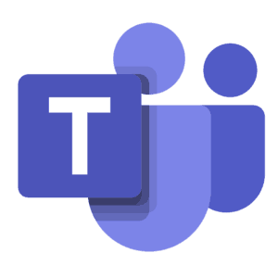
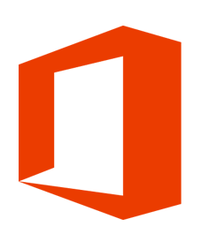
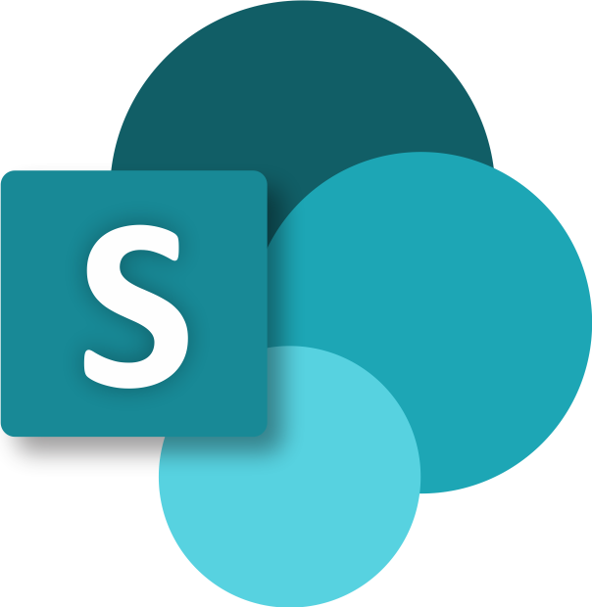
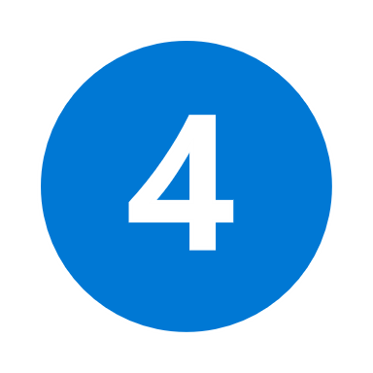

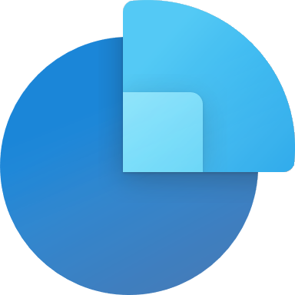




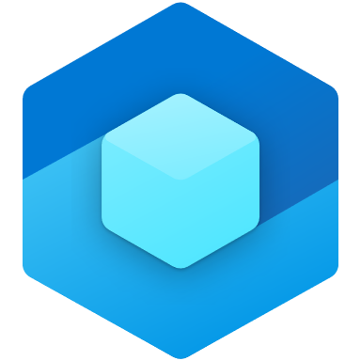

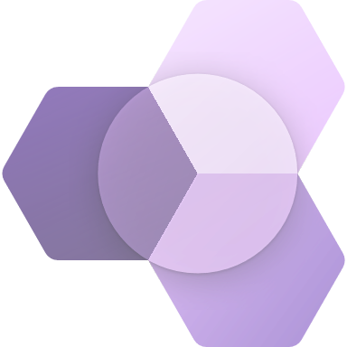





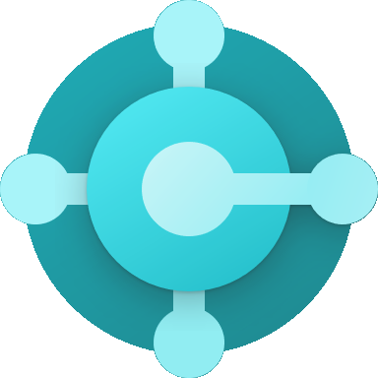


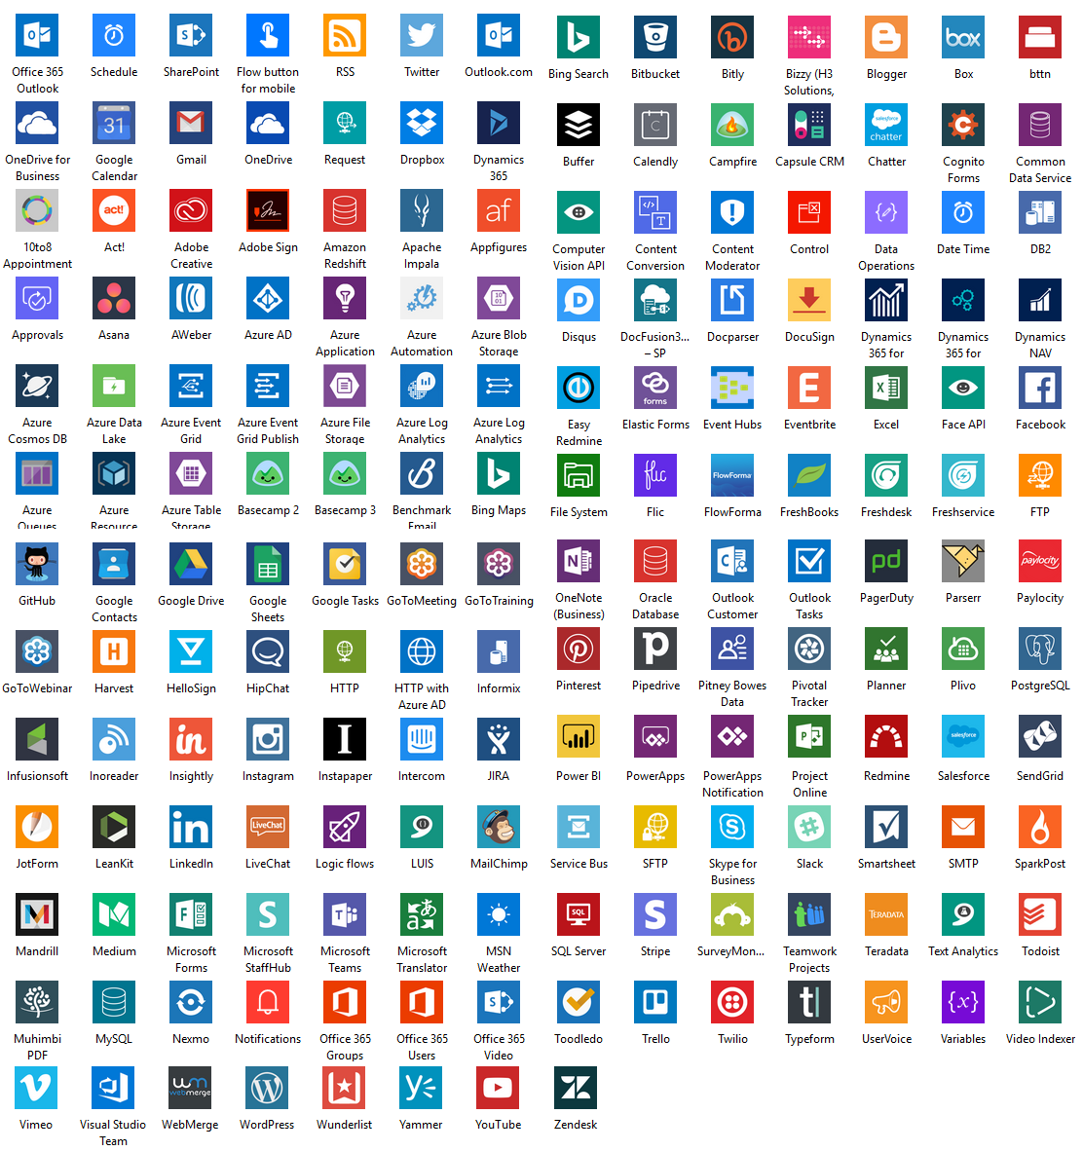
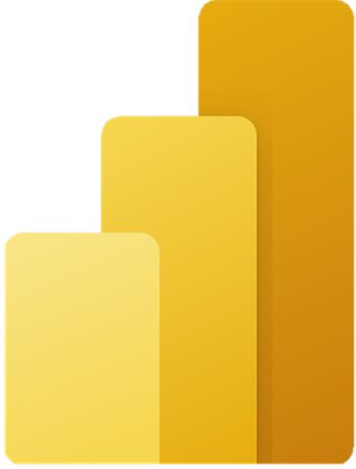
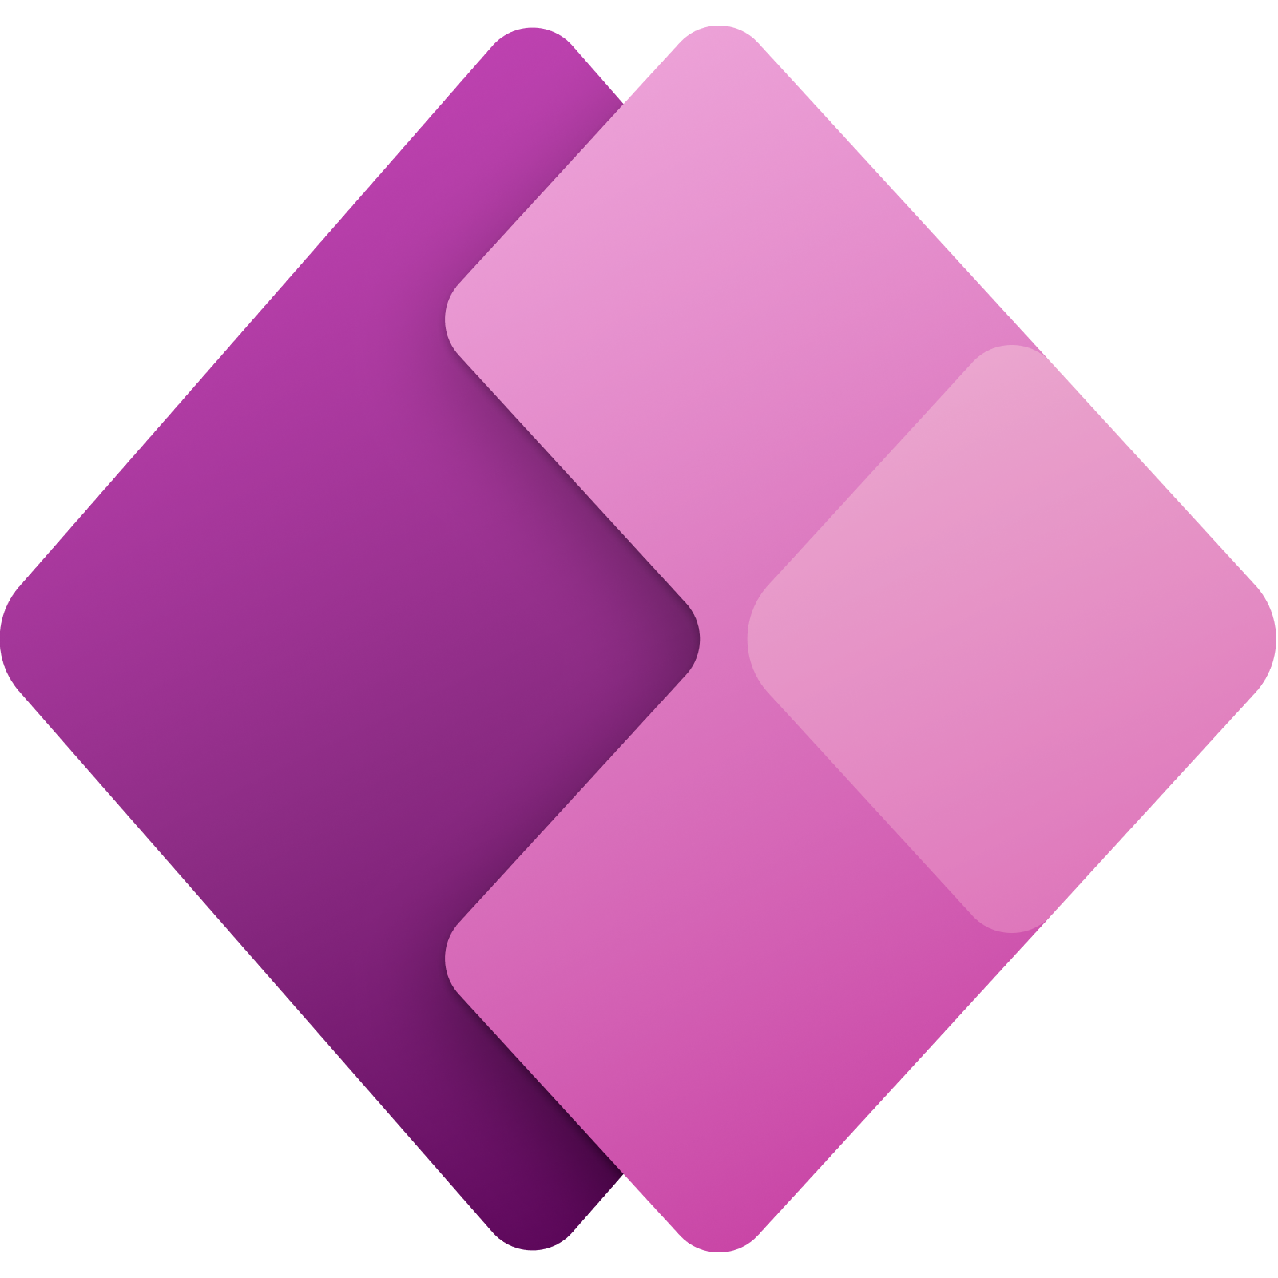


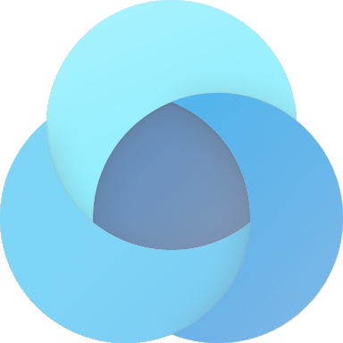

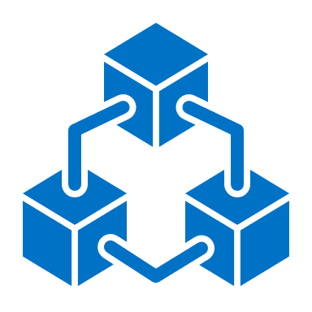


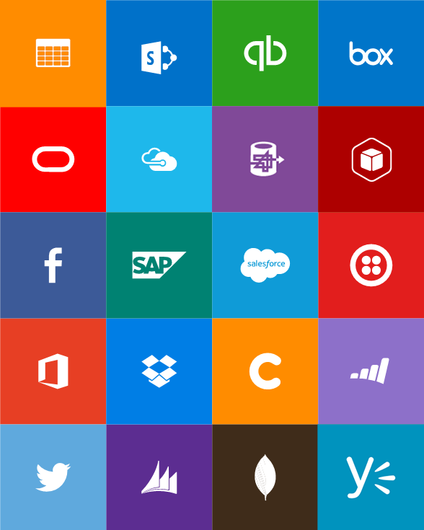
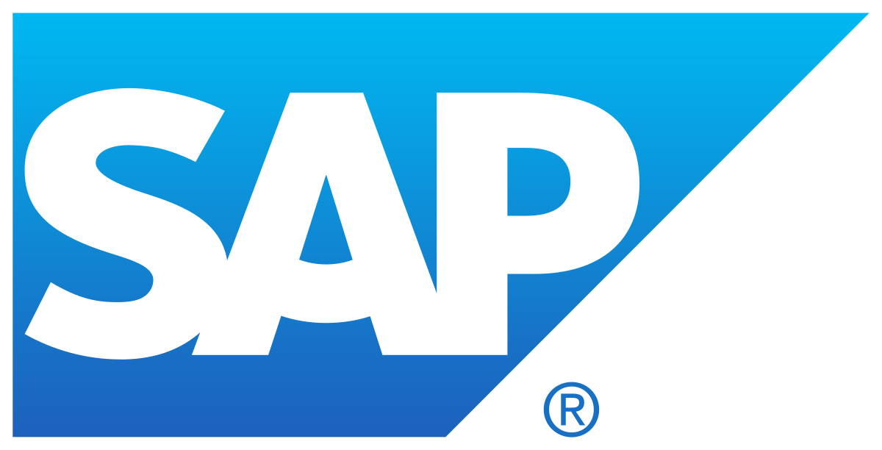
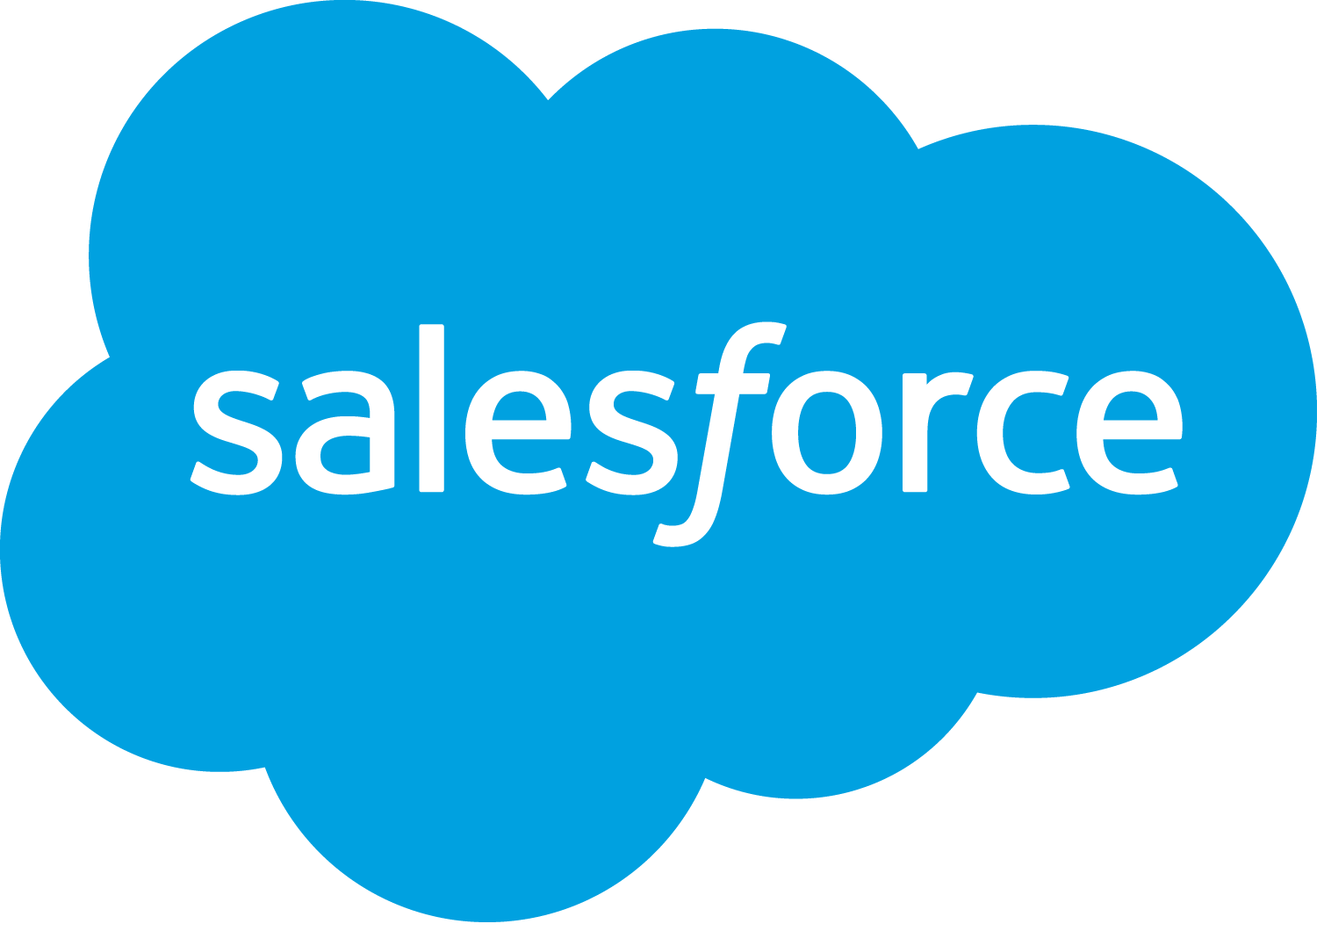


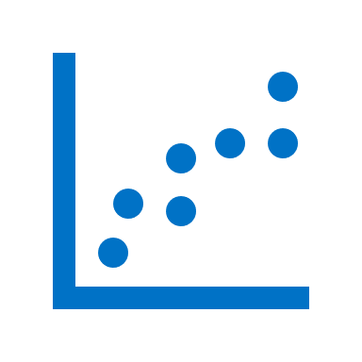

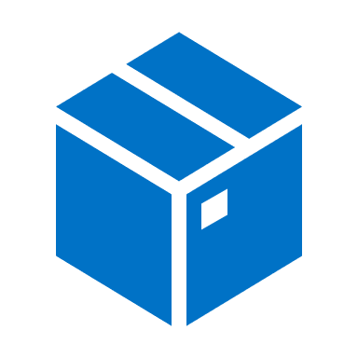
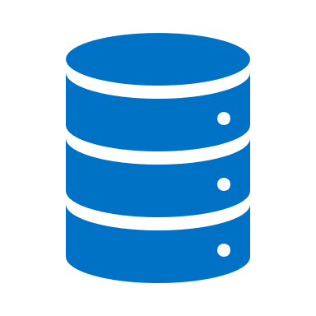






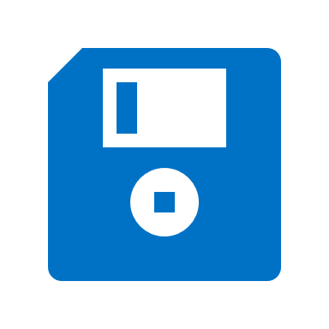
Microsoft’s Business Applications are built on Azure, using a Common Data Model that unifies data in Dataverse. Power Platform is the low code extensibility solution for Microsoft’s Office 365, Teams, Dynamics 365 business applications (CRM & ERP) and integrates with 400+ services.
Microsoft Business Application Solution Ecosystem
AI Platform & MS Research (25+ years)
18,000+ Patents | Cognitive Services
Human Parity Machine Learning | Decision, Language, Speech, Vision
720M+ Professionals
720M+ Professionals | Sales Navigator
 | Microsoft 365
Identity | Outlook | Teams 115M+ Daily Active Users | Office | Sharepoint | OneDrive | Excel
64K+ Partners
135M+ Users
Analyst Recognition: 1) Analytics & BI
2) API Management (Full Lifecycle)
3) Cloud DBMS
4) Cloud Infrastructure
5) Content Services Platforms
6) CRM Customer Engagement
7) CRM Customer Service Solutions
8) CRM Lead Management
9) CRM Sales Force Automation
10) Data Integration Tools
11) Data Science & ML
12) ERP (Cloud)
13) Iot (Industrial)
14) Low-Code App Platforms
15) Meeting Solutions
16) Robotic Process Automation (RPA)
17) Security: Access Management
18) Security: Cloud Access Security Brokers
19) Security: Endpoint Protection
20) Security: Ent. Information Archiving
21) Security: Unified Endpoint Management
Dynamics 365
Marketing | Sales | Customer Service | Virtual Agents | Field Service | Product Visualize | Remote Assist | Commerce | Connected Store | Fraud Protection | Supply Chain | Guides | HR | Finance | Project Operations | Business Central
Power Platform
Power BI 7M Users | Power Apps | Power Automate | Power Virtual Agents | Power Portals
Customer Data Platform (CDP)
Customer Insights | Customer Voice
Dataverse
Dataverse for Teams | Common Data Model | Cloud Services APIs | 400+ Connectors
Industry Solutions
Azure (600+ Services)
AI & ML | Analytics | Blockchain | Compute | Containers | Databases | Dev Tools | DevOps | IoT | Media | Networking | Security | Storage
200 Microsoft Services
Microsoft Security Response Center
7 Trillion cyber events daily = Threat Intelligence
Security
Microsoft Trust Center
Compliance
Transparency
nickfratello V.2020.02

